Slide 1
Conversational Voice Controlled
News Application
Mohd Gulam Ansari (242CS023)
Prathamesh Jadhav (242CS020)

Slide 2
Overview
Introduction
Literature Survey
Problem Statement
Objectives
Methodology
Experimental Setup
Expected Outcomes
Conclusion

Slide 3
Introduction
Traditional news gathering methods like newspapers, radios, and televisions, while effective, often lack interactivity and convenience. The Conversational Voice Controlled News Application is an innovative platform designed to enhance user interaction by allowing seamless, hands-free access to news content. This project leverages voice recognition technology, enabling users to browse, search, and consume news articles through voice commands.
Motivation
As technology evolves, smartphones and computers have become popular tools for accessing news, though many still require manual interaction.
Visually impaired individuals face significant difficulties navigating conventional news applications,creating a strong need for solutions that empower them to browse and consume news independently.

Slide 4
Literature Survey
In “Voice Assistants and Smart Speakers in Everyday Life and in Education,” Terzopoulos and Satratzemi (2019) highlight the role of voice assistants in enhancing accessibility, especially for users with visual impairments.
The paper “An Intelligent Voice Assistance System for the Visually Impaired” explains how such systems improve accessibility by providing real-time environmental information through text-to-speech conversion.
Research Gaps
Many apps offer voice search features, but few provide comprehensive, conversational interfaces that allow users to control the entire news browsing experience through voice commands.
Many news apps aggregate content from specific sources but may not be optimized for real-time news updates across a wide variety of sources.

Slide 5
Problem Statement
Traditional news platforms rely heavily on visual interfaces, making it difficult for visually impaired individuals to browse and access news content autonomously. This application aims to provide hands-free, voice-controlled access to news, enabling users with visual impairments to interact with the app seamlessly using voice commands, improving their independence and user experience​.

Slide 6
Objectives
Create a responsive and fully functional news platform that users can interact with entirely through voice commands.
Integrate news APIs (such as NewsAPI, GNews API, Bing News Search API, and Mediastack) to fetch and display up-to-date news from various reliable sources.
To access the app using voice commands we are going to use Speech-to-text technologies.
Design the application to be responsive and functional across a wide range of devices, including desktops, tablets, and smartphones.

Slide 7
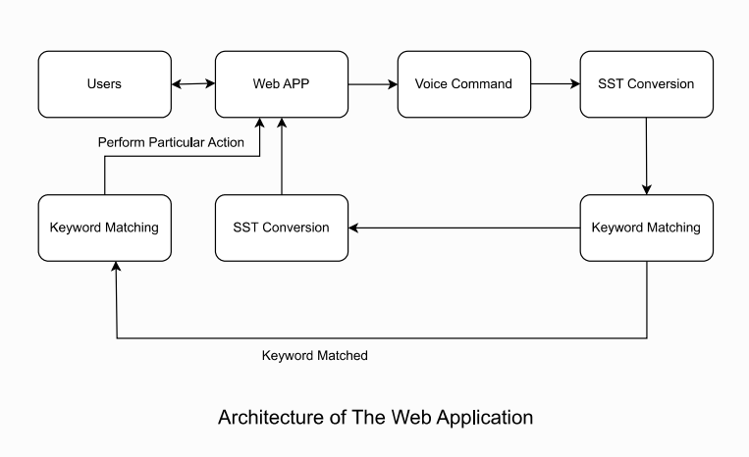
Methodology
This flow ensures a user-friendly experience with smooth handling of both successful interactions and errors.
The user provides a voice input to the web application.
The web application sends the voice signal to a speech-to-text service.
The speech-to-text service converts the voice signal into text.
The converted text is sent for keyword matching.
The web application displays or reads out the error message to the user.
Once the task is completed, the results are shared with the web app.
The web application sends a voice reply to the user, completing the interaction.

Slide 8
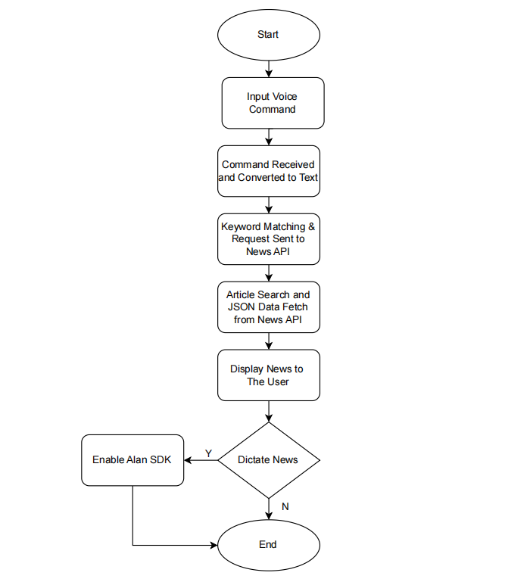
Web Application Flowchart

Slide 9
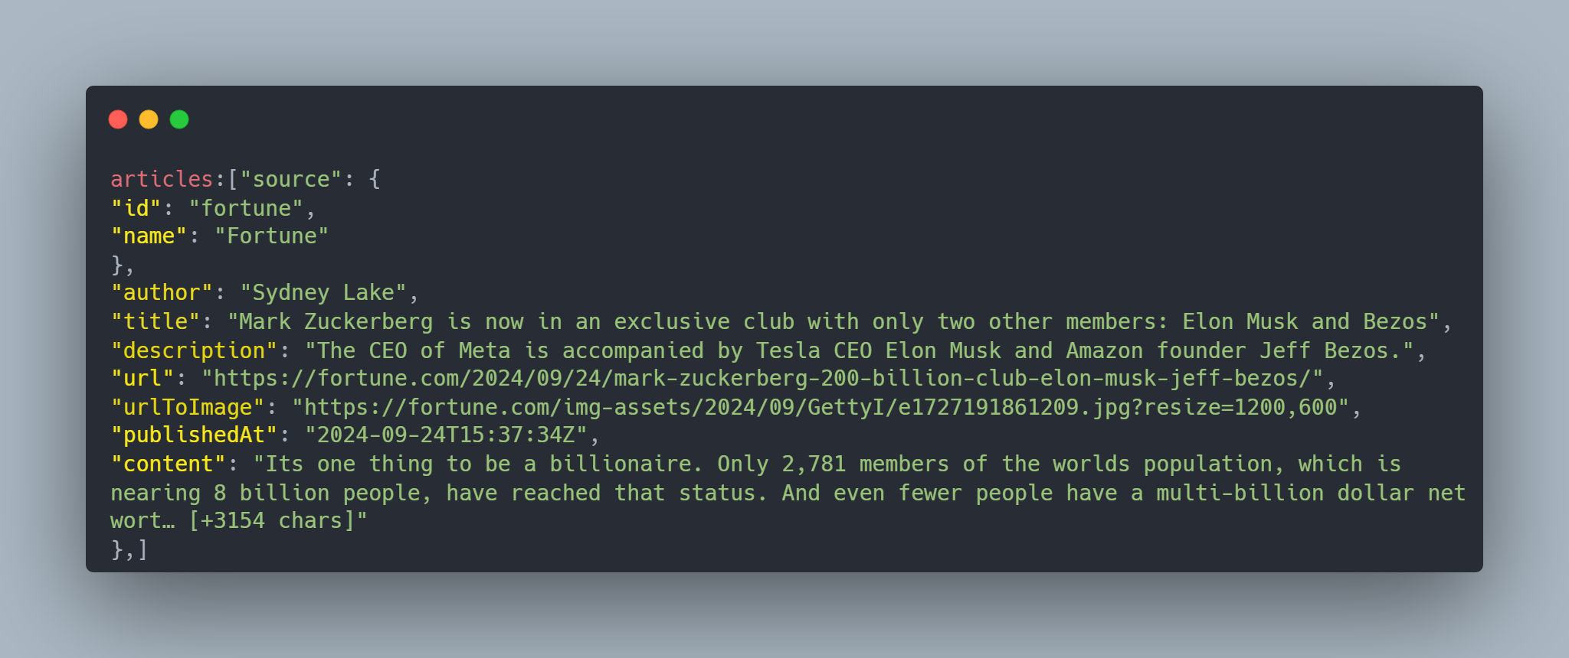
Dataset
We will use json response data from various news api as well as web scraping method to collect data regarding news articles from web sources. Below is the sample response along attribute and value specification

Slide 10
Experimental Setup
Experimental setup can be broken down as follows.
Development Environment :
Frontend Framework: ReactJS (v18.0)
Alan AI Integration: Set up the Alan AI SDK within the React project to allow voice control features.
Backend Services:
News API: Use an API like NewsAPI or similar to fetch news data based on the user’s voice input.
Speech-to-Text (SST): Ensure Alan AI provides speech-to-text conversion integrated with the app’s functionality.
Tools and Technologies:
Axios or Fetch API for data retrieval from the news API.
Node.js and npm for package management.
Hardware requirement :
A laptop or desktop with a microphone to provide voice input.
Mobile device testing to ensure cross-platform compatibility.
How it works:
Cloud providers can absorb DNS flood traffic by distributing it across a large, globally distributed infrastructure. They use advanced AI-based traffic filtering, rate limiting, and IP reputation filtering to scrub malicious traffic before it reaches the DNS servers.
This ensures that legitimate DNS traffic still gets through, while malicious traffic is discarded in the cloud.

Slide 11
Expected Outcomes
User Interface Design
Simple and Accessible Design: To build user interface which is clean, intuitive, and accessible to all users.
News Dataset Collection :
Data Source: Collect news articles from trusted sources (via APIs like NewsAPI) based on various categories such as technology, sports, politics, etc. and from various sources.

Slide 12
Conclusion
By utilizing advanced Speech-to-Text technologies and frameworks like React and Redux,The Conversational Voice Controlled News Application provides an innovative and accessible solution for visually impaired users, enabling them to navigate and consume news content entirely through voice commands.
Future Scope
Currently,this web app is only capable to support English language as a input. There is potential for further development of multilingual voice recognition systems which can support languages like Hindi.

Slide 13
Thank
You

